Slide 1
CarePlus Hospital Appointment Analytics
Presented by: Bala Abineshwar

Slide 2
Introduction
CarePlus Hospital Appointment Analytics focuses on analyzing hospital appointment data to understand patient activity, appointment performance, revenue, and operational efficiency.

Slide 3
Objectives
Analyze overall appointment performance
Identify trends in appointments and revenue
Understand patient and hospital-related patterns
Evaluate operational metrics such as wait time and appointment status
Generate actionable insights to support better decision-making

Slide 4
Dataset
Domain: Healthcare / Hospital Appointments
Period: January – June 2025
Appointment Records: 808
Dataset includes these 5 Tables- appointment transactions, hospitals, doctors, departments and holidays

Slide 5
Tools Used
Microsoft Excel
Formulas & Functions
PivotTables
Charts & Visualizations
Slicers
Excel Dashboard

Slide 6
Data Cleaning
Checked the dataset for missing and inconsistent values
Reviewed duplicate appointment records
Standardized data formats
Verified appointment, payment, and categorical fields
Checked the data before performing analysis

Slide 7
CarePlus Hospital Appointment Analytics Dashboard
Key Performance Indicators
Total Revenue: ₹671,650
Appointments: 808
Average Wait Time: 26.43 minutes
Average Rating: 3.92 / 5

Slide 8
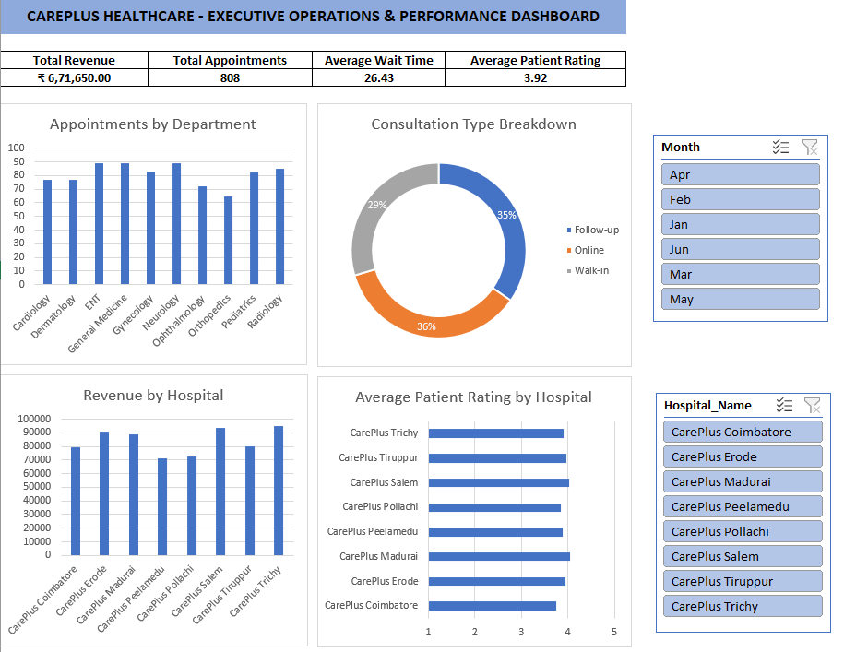
Dashboard Analysis
Appointment Status
Monthly Appointment Trends
Revenue Analysis
Department Performance
Hospital / Location Performance
Patient & Payment Analysis

Slide 9
Key Insights
April recorded the highest number of appointments with 144 appointments
Sunday was the busiest day with 127 appointments
April revenue was the highest at ₹120,700
Cardiology had the highest average wait time at approximately 51 minutes
Neurology generated approximately ₹113,100 in revenue
Trichy recorded the highest appointment volume with 117 appointments
526 appointments were completed
149 appointments were cancelled and 133 were no-shows

Slide 10
Business Observations
Appointment demand is relatively higher during certain periods, especially Sundays
Higher patient volume can create additional pressure on hospital operations
Cardiology's higher waiting time indicates a potential capacity or scheduling challenge
Neurology's strong revenue contribution makes it an important department to monitor
Cancelled and no-show appointments represent opportunities to improve appointment utilization
Appointment patterns can help hospitals plan staff and resources more effectively

Slide 11
Recommendations
1. Improve Scheduling
Plan additional staff or appointment slots during high-demand periods such as Sundays.
2. Reduce Waiting Time
Review Cardiology scheduling and capacity to identify ways to reduce patient waiting time.
3. Reduce No-Shows
Use appointment reminders and confirmation messages to reduce missed appointments.
4. Improve Appointment Utilization
Monitor cancellations and no-shows regularly and consider better slot management.
5. Monitor Department Performance
Continue tracking revenue, appointment volume, and waiting time by department to support operational decisions.

Slide 12
Conclusion
The analysis provided a clear view of appointment activity, revenue, patient patterns, and operational performance at CarePlus.
The dashboard helps identify areas that require attention and supports data-driven decision-making.
Key Learning
Improved my Excel data analysis skills
Learned to work with real-world business data
Practiced data cleaning and validation
Created PivotTables, charts, and an interactive dashboard
Learned how to convert data findings into business recommendations

Slide 13
Thank You
Questions & Answers

